Slide 1


Green Pace
Security Policy Presentation
Developer: Phillip Cabaniss
Notes:
This presentation will cover subjects such as coding standards, principles, and tools we use throughout development to help ensure your software is secure.

Slide 2

OVERVIEW: DEFENSE IN DEPTH
This security policy will act as a guide for our developers to follow. It will support them in maintaining a secure development environment and mitigate and eliminate potential issues.
Notes:
As you can see all aspects of development can and should incorporate some aspect of security.

Slide 3
THREATS MATRIX
The threats matrix helps by organizing issues that may be common or uncommon. As well as put priority to issues that may need immediate attention.
Likely Threats that are more likely to happen | Priority High-risk issues that may affect system or user
Low priority Standard, uncommon issues that do not affect the functionality or security. | Unlikely Threats that are not common.

Slide 4
10 PRINCIPLES
Validate Input Data
Heed Compiler Warnings
Architect and Design for Security Policies
Keep it Simple
Default Deny
Adhere to the Principle of Least Privilege
Sanitize Data Sent to Other Systems
Practice Defense in Depth
Use Effective Quality Assurance Techniques
Adopt a Secure Coding Standard
Notes:
Principles
Write a short paragraph explaining each of the 10 principles of security.
1. Validate Input Data
Validating user input is the process of checking any data entered by the user. This is extremely important because the wrong input could jeopardize your system, or data within. It could also lead to errors or buffer overflows that could leave your program open to potential attacks.
2. Heed Compiler Warnings
Heeding compiler warnings is an important step in development. These warnings are put in place by other developers to make development on the IDE more secure. If there is a warning, it should be investigated and remediated as soon as possible.
3. Architect and Design for Security Policies
Security is never something that should be left to the end of a project. Designing while keeping security as a priority through development will ensure more secure code. If it was left to the end of the development cycle, those changes are liable to break your program and end up costing you more time and money. Lastly, designing with security in mind allows for swifter mitigation of potential issues in the future.
4. Keep It Simple
A more complicated design can lead to more vulnerabilities that are overlooked. A simple design will lead to cleaner, more efficient code, as well as making future maintenance on the system easier as well.
5. Default Deny
This is the principle that states if permission is not explicitly granted, it is denied. Leaving a grey area could lead to potential attacks in the future or lead to data leaks.
6. Adhere to the Principle of Least Privilege
Like default deny, the principle of least privilege states that a user should only have access to enough information, resources, or applications to complete the desired task. Any more privilege could lead to potential issues or attacks.
7. Sanitize Data Sent to Other Systems
The process of ensuring that data conforms to the requirements of subsystems, or other systems before it is sent. This can involve deleting storage data so it may not be recovered for the sending systems, cryptographically sealing the data, or the physical destruction of servers.
8. Practice Defense in Depth
Defense in depth is a strategy in which a series of defensive mechanisms are put in place to mitigate or prevent potential threats. Think of the firewall on your computer, or a 2-factor authentication system. Multiple tools are used in “layers” to ensure the security of an application.
9. Use Effective Quality Assurance Techniques
Effective quality assurance is the backbone of security in an application. This is the process of vigorously testing applications before and after release. Principles such as test-driven development, code review, and integration testing are some examples of quality assurance techniques.
10. Adopt a Secure Coding Standard
Establishing guidelines can ensure that developers adhere to correct security principles throughout development. Secure coding principles aren’t a 100% fix, but they aim to increase the security of your code, which in turn increases the security for your users and their data. Coding standards also ensure that future work on the program can be picked up easily without threatening to break any existing code in place.

Slide 5
CODING STANDARDS
Coding Standard | Label | Name of Standard
Data Type | STD-001-CLG | Implement abstract data types using opaque types.
Data Value | STD-002-CPP | Do not cast an out-of-range enumeration value.
String Correctness | STD-003-CPP | Guarantee that storage for strings has sufficient space for character data and the null terminator.
SQL Injection | STD-004-JAV | Prevent SQL injection.
Memory Protection | STD-005-CPP | Detect and handle memory allocation errors.
Assertions | STD-006-CLG | Use static assertions to test the value of a constant expression.
Exceptions | STD-007-CPP | Handle all exceptions thrown before main() begins executing.
Data Protection | STD-008-JAV | Do not expose private members of an outer class from within a nested class.
Data Value | STD-009-CPP | Value-returning functions must return a value from all exit paths.
Memory Management | STD-010-CPP | Do not access freed memory.
Notes:
Implement abstract data types using opaque types.
Abstract data types are not restricted to object-oriented programming languages like Java and C++. This should be used in C programming languages as well. Abstract data types are most effective when used with private data types and information hiding.
Do not cast an out-of-range enumeration value.
The arithmetic value being cast must be within the range of values the enumeration can represent. By doing so, we ensure that we follow the rules of the intended design of enum constructs. We also promote easy-to-read code and reduce the risk of undefined behavior.
Guarantee that storage for strings has sufficient space for character data and the null terminator.
When you copy or insert a string to another string with insufficient space, it can lead to issues such as buffer overflow. This can leave vulnerabilities in your code, allowing for unwanted hackers to gain access to sensitive data.
Prevent SQL injection.
When accepting input from outside sources, this can lead to SQL injection. Thus, leading to the possibility of data being stolen. It can be prevented with proper input validation to ensure that incoming data is clean.
Detect and handle memory allocation errors.
Memory allocation errors can lead to multiple issues with loading and retrieving data, or even crash the program. Anytime we initialize or modify a string, vector, or map, we are allocating memory on the heap. Using the “new” operator in the C standard library may or may not throw an error, so we must have checks in place to prevent these issues.
Use static assertions to test the value of a constant expression.
Assertions are used to test the value of expressions in multiple programming languages. They ensure that the values are consistent and improve code reliability.
Handle all exceptions thrown before main() begins executing.
Exceptions are a way of telling us of issues in our program without crashing it entirely. However, these exceptions must be handled early to ensure potential issues are resolved.
Do not expose private members of an outer class from within a nested class.
Ensuring that the private member stays secure within nested classes will reduce any unintended access and prevent unwanted code from running on your program.
Value-returning functions must return a value from all exit paths.
A function that is supposed to return a value but does not can result in undefined behavior. It also leaves your code vulnerable to attacks from malicious users.
Do not access freed memory.
Evaluating a pointer into a memory address that has been deallocated by a memory management function can lead to undefined behavior. Dangling pointers are memory that has been deallocated and can result in exploitable vulnerabilities.

Slide 6
ENCRYPTION POLICIES
Encryption at rest: Protecting data while it is in databases or on devices. This kind on encryption should always be implemented wherever data is being stored to safeguard sensitive data and prevent exposure.
Encryption at flight: To protect data in transit, we must ensure the proper tools are utilized so that data keeps its integrity and no harm from altered or eavesdropped data. Encrypting files before and after transit should always be practiced.
Encryption at use: Ensuring that data is valid and secure during processing is encryption in use. This allows data to be utilized with confidence and security to be maintained while in use, preventing unauthorized access.

Slide 7
TRIPLE-A POLICIES
Authentication: Validating credentials or user input is a necessity in systems to allow and maintain access to information and content. It also ensures that the right person maintains important systems like making changes to the database rules or structure.
Authorization: Controlling access and specifying levels of content users can access is authorization at work. Authorization should be implemented to control user permissions and create role systems like system techs and admins. Using the principle of least privilege as a guideline for implementation, all systems that need to limit access should use authorization.
Accounting: Keeping track of user activities and system status to maintain a safe environment and help mediate any errors that arise in accounting. When we audit or implement unit or stress testing on a system to regulate security, we ensure that we have a solid defense against potential threats. It also ensures that we keep with regulation and play our part in the protection of our users and employees.

Slide 8
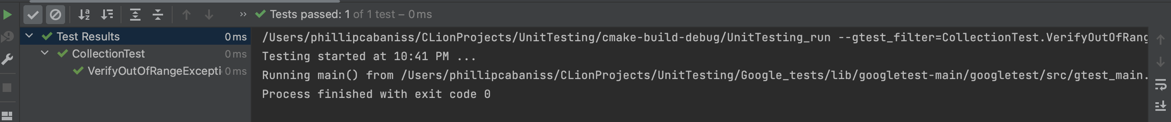
Unit Testing
Single Test: Verifying Out of range exception is thrown.
I incorporated unit testing to help ensure that our code is sound, secure, and free of bugs. For this example, I made a unit test that checks if an out-of-range exception is thrown. This helps verify that we have the proper error handling to react to this problem if it should arise. In the image, you can see that the test ran successfully and the system detected the error successfully. Using gTest (Google Test), and a good IDE, we can easily create and run these tests.

Slide 9
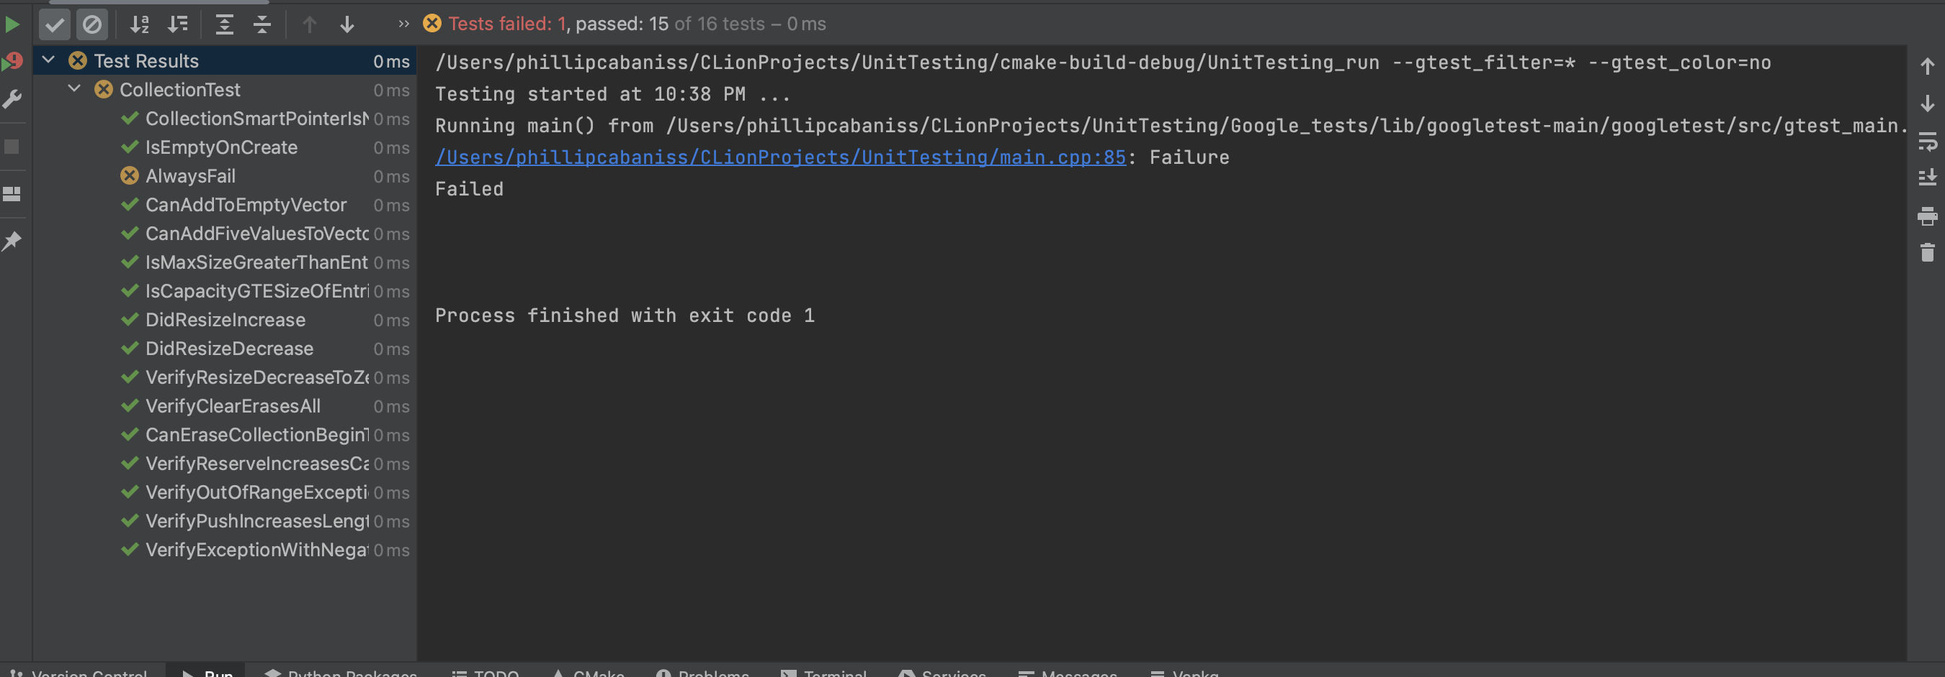
Unit Testing
Multiple Tests: Testing an entire class.
In the image below, you can see how we incorporated unit testing into every aspect of the program when run. This ensures that most basic errors and vulnerabilities are handled and mitigated properly. Google Tests work very well when testing a full program, it will display the results to better help us pinpoint issues in code.

Slide 10

AUTOMATION SUMMARY

Slide 11
TOOLS
DevSecOps is a tool that is essential to any development project (Michali). It is known for being an effective guide to delivering secure software. Essentially, it emphasizes incorporating security from the very beginning and throughout every part of the development process. This ensures that your application is secure in every aspect and saves on development costs that could arise from expensive code reworks. DevSecOps operates in pipeline phases that help with integration with other tools. Threat modeling, Security scanning and testing, security analysis, remediation, and monitoring are the 5 phases. Common programs have built-in features to work well with DevSecOps. For example, the previous information about unit testing is a great example of how security scanning and testing uses the built-in compiler to run and explain the tests and catch any errors. This is what's known as security automation, and it drastically helps with development.

Slide 12
TOOLS
Many tools work in conjunction with DevSecOps, here are the most important:
- Static application security testing (SAST): Scans for common issues in source code.
- Dynamic application security testing (DAST): Scans apps at runtime to detect issues.
- Interactive application security testing (IAST): Combines the previous two into a single solution.
- Source composition analysis (SCA): Identifies libraries and dependencies associated with vulnerabilities.
- Vulnerability scanners: A category of tools that detect issues that compromise security.

Slide 13
RISKS
Nothing is ever 100% secure. Vulnerabilities and attacks will always be an ongoing threat to software. The best steps we can take is to ensure that products are as secure as possible and proper mitigation strategies are implemented.
Time and time again it has been proven that if you wait to implement security into your applications, it can be very costly. Not only will it create an environment for potential threats to arise, but it will also show your customers /employees that you don’t value their security. Many companies have lost credibility due to attacks that could have been prevented with security implementation.
Costs are another major factor in waiting. Both with possible mitigation to attacks, but also in development when you are forced to rework a program from the ground up.

Slide 14
BENEFITS
Solutions to common issues and having the peace of mind that your system is secure against common issues. Incorporating security principles throughout development will give you and your users more peace of mind.
Hackers and other potential threats to your system will have trouble exploiting common vulnerabilities that arise in development.
You won't have to waste time or money in the development process because it will be implemented throughout every aspect. Ensuring that security remains a constant practice.
Educating staff on these principles will not only make the application more secure but instill these lessons in your developers as well. The company will gain stronger, more secure employees who understand how to implement these policies.

Slide 15
RECOMMENDATIONS
Our current security policy covers most common issues, but as mentioned before, a program is never 100% secure. As technology advances, so must programs and applications develop new and more robust security policies.
For example, Dollar Tree had an unforeseen incident due to their third-party service, Zeroed-In Technologies being hacked (Toulas). Though the attack was not directly against Dollar Tree, their users were the ones who suffered due to the data breach. Threats like these we may not be able to prevent, but we can mitigate the possible damage caused by having the correct policies in place.
Our future goal is to remain flexible and consistent with ever-changing threats to our products. For now, we have goals to keep your products safe, but in the future, we plan to implement even stronger policies to fight off potential threats and guard data.

Slide 16
CONCLUSIONS
In conclusion, we aim to provide you with secure software to prevent possible attacks or catch potential vulnerabilities before they are exploited. We aim to stay consistent and up-to-date on the most recent security policies and defenses to ensure your program is always as secure as possible. We also understand that not all threats will be prevented but can create the proper strategies to mitigate unforeseen issues. With DevSecOps and security principles like the principle of least privilege, we can create robust and secure software.

Slide 17
REFERENCES
Michali. (2022, September 15). What is a DevSecOps Pipeline? Check Point Software. https://www.checkpoint.com/cyber-hub/cloud-security/devsecops/what-is-a-devsecops-pipeline/
Toulas, B. (2023, November 29). Dollar Tree hit by third-party data breach impacting 2 million people. BleepingComputer. https://www.bleepingcomputer.com/news/security/dollar-tree-hit-by-third-party-data-breach-impacting-2-million-people/

